Slide 1

HIRING PROCESS ANALYTICS
SWAGATIKA SAMAL

Slide 2

Agenda
Introduction
Tech Stack Used
DataSet Used
Questionnaire
Approach
Summary
Conclusion

Slide 3

Introduction
The recruitment process stands as a pivotal element within any organization, and gaining insights into key metrics such as rejection rates, interview frequencies, job categories, and open positions can offer valuable information for the HR department.
As a data analyst, I have been entrusted with a dataset encompassing records of past hires. My responsibility involves delving into this data to address specific questions aimed at enhancing the company's hiring procedures. The analytic skills will play a crucial role in extracting meaningful conclusions that can guide the organization toward refining and optimizing its hiring processes.

Slide 4
TECH STACK USED
I have used
Microsoft Excel to solve the questionnaire
Microsoft Power Point to prepare the presentation

Slide 5

QUESTIONNAIRE & APPROACH
Let’s dive in

Slide 6

Data Cleaning
The "event_name" column had 15 rows with "-" values, considered as Null values, which I replaced with "Don't want to say" since both convey the same meaning in the context of this project, indicating an unknown gender of the candidate.
In the "Offered Salary" column, I identified 1 row with a Null Value. The corresponding values in the "Department" and "Post Name" columns were "Sales Department" and "i7," respectively. I replaced it with the median of the offered salary for the "Sales Department" and "i7" Post Name.
Additionally, the "Post Name" column had 1 row with a "-" value, considered a Null value. The associated values in the "Department" and "Offered Salary" columns were "Sales Department" and "85,914," respectively. I replaced it with the majority count of posts for candidates in the Sales Department with an offered salary between 85,000 and 96,000, resulting in "c9.“
The "Post Name" column contains a category labeled as "c-10," which appears to be a typing error. I have corrected this to the accurate category, which should be "c10."

Slide 7
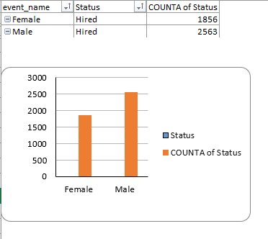
Goals for Q1
Gender Distribution of Hires
Representation as a graph
It is the number of males and females have been hired by the company.
The data was first filtered for male and female candidates those are hired using filter option in the column status and event_name.
The data is then converted to pivot table and then the results are calculated accordingly.

Slide 8
Goals for Q2
Average salary offered by the company
Solution
The average salary is calculated by adding up the salaries of a group of employees and then dividing the total by the number of employees.
The average salary can be calculated using AVG function.

Slide 9
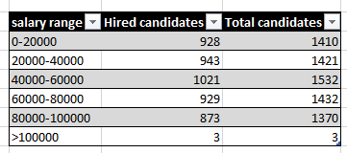
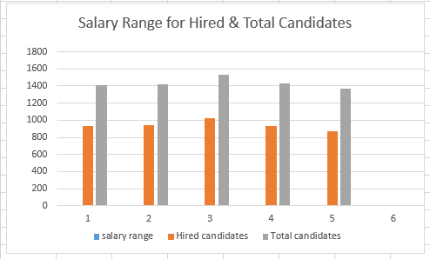
Goals for Q3
Salary Distribution of Hires & Total Candidates
Representation as a graph
It is the number of males and females have been hired by the company.
First I separated the data into salary range of 20000.
Then data was filtered for hired candidates within the salary range using filter option in the column status .Then the count was calculated
In the similar way, counting was done without applying filter within the salary range for calculating total candidates within the salary range.

Slide 10
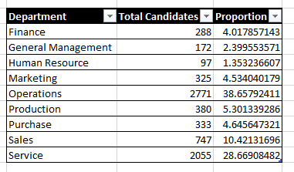
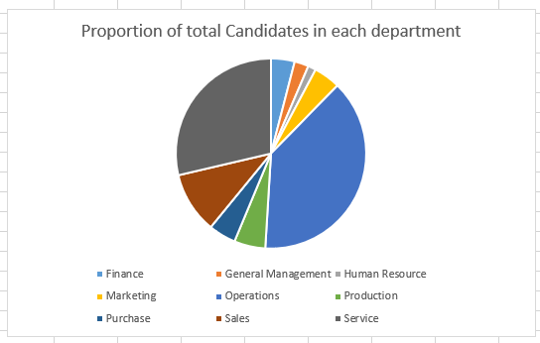
Goals for Q4
Proportion of Total Candidates in each Department
Representation as a graph
First the filter was applied in the Department column.
Then the number of candidates was calculated in each department.
Then proportion was calculated using formula
(Table3[[#All],[Total Candidates]]/7168)*100

Slide 11
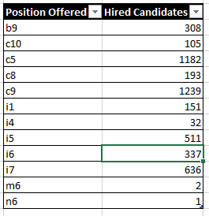
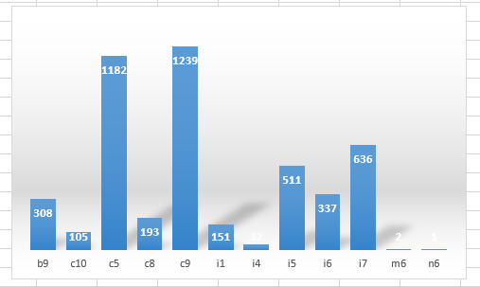
Goals for Q5
Different position tires of hired candidates
Representation as a graph
First the filter was applied in the Status column for hired candidates
Then the number of candidates was calculated for each position applying filter in Post Name column.

Slide 12





Summary
From the 1st graph we can understand more males have been hired than females.
The salary distribution for hired candidates mirrors a consistent pattern, with the majority being recruited for mid-level positions and the least for senior roles.
The Average Salary of Hired Candidates is Currency-Unit 49594.91.
The Operations Department has the highest number of hires, followed by the Services and Sales Departments, while the Human Resource Department has the fewest hires, as indicated in the pie chart.
We can observe that maximum offered salary is in the interval of Currency-Unit 40000–60000 while minimum offered salary are in intervals of Currency-Unit >100000

Slide 13

Engaging in this project enlightened me about the significance of Data Analytics in the hiring process, offering crucial insights like rejection statistics, reasons for rejections, applicant profiles, and vacancies. These insights empower the hiring department to make informed, data-driven decisions.

